Slide 1
Letterkenny DotNet Azure User Group
2018
Letterkenny, Ireland
Date: Saturday, 10th Nov Time: 9:00AM – 5:30PM
Organized By:
The Microsoft User Group for Donegal County
http://lk-mug.org
@lkmsug
Letterkenny
.MUG

Slide 2
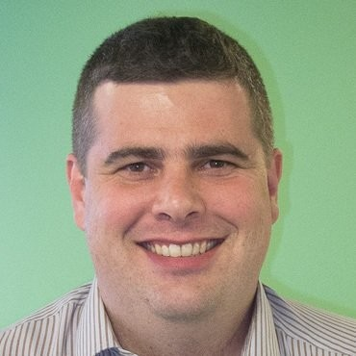
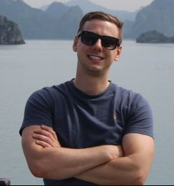

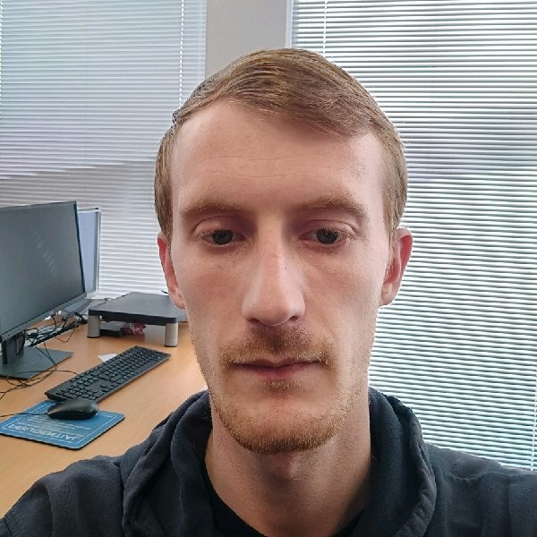
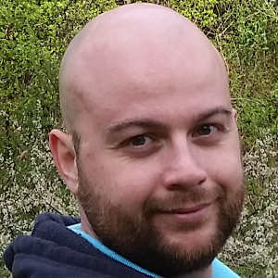


A Big Thanks To All Speakers
Joon Du Rant
Ray Hogan
Richard Fisher
Austin Breslin
Velin Georgiev
Letterkenny, Ireland

Slide 3

#O365DevBootcampLK
Lets have some swag…

Slide 4






Letterkenny, Ireland
Sponsors:
Date: Saturday, 10th Nov Time: 9:00AM – 5:30PM
Venue & Refreshments
RAFFLE for one, 1 year license
RAFFLE for one, 1 year license
Event, Swags, T-Shirts
Letterkenny
.MUG

Slide 5

LK-MUG
LK Community is for everyone interested in Microsoft .NET, Office-365, SharePoint, Azure cloud platform and other Microsoft Open Source initiatives.
Letterkenny
.MUG
We are a Microsoft recognized user group established in Letterkenny, work under the umbrella of .NET foundation.
All skill levels are welcome.
We are committed to helping you learn and share things about .NET, Office-365, SharePoint and Azure Cloud.
Our community brings all students, enthusiasts, experts and professionals working in and around Letterkenny/Donegal.
Time to time you will be seeing events organized by Microsoft and MVPs to provide best-in-class learning experience for Microsoft Technology enthusiasts.
Attention!
Looking for local speakers to future UG sessions in Letterkenny. If you are interested to take up any sessions, please email
lk-mug@outlook.com
Letterkenny DotNet Azure User Group (Letterkenny Microsoft User Group)
- An ultimate Microsoft developer and IT Pro community for Donegal.
Letterkenny, Donegal, Ireland

Slide 6
Upcoming Events

Slide 7


Join Us Website: http://www.lk-mug.org Meet up Url: https://www.meetup.com/lk-mug/ Twitter: https://www.twitter.com/lkmsug Facebook: https://www.facebook.com/lkmsug Hashtag: #lkmug
Join Our Other Meetups
ThingX-LY IoT Meetup
https://www.meetup.com/thingx-ly
LetterkennyJS (Javascript Meetup)
https://www.meetup.com/letterkennyjs

Slide 9

Call to action
(Recommendation to Bootcamp organizers and speakers: This slide can be used at the end of the Bootcamp to have attendees to fill online feedback form and recommendation for their ongoing learning and app development on Office 365 platform. Please keep the first three bullet points, you can update the last bullet point to be the user group or community that you are leading that you’d like attendees to join and learn more. Please keep the first feedback bullet point at the top and feel free to re-arrange the rest of bullet point orders. Thanks.
Register for Our Bootcamp: https://lnkd.in/ee8STGe
Join Office 365 developer program https://dev.office.com/devprogram to leverage all resources for Office 365 development learning
Attend the event, learn to Build applications on Office 365 platform
Attend MVP led local community events to continue learning on Office 365 development
https://meetup.com/lk-mug

